Slide 1



Noida Institute of Engineering and Technology, GR. Noida (An Autonomous Institute)
School of Computer Science & Engineering
Theory of Automata and Formal Languages
(ACSE0404)
Unit: 2
Regular Language and Finite Automata
Jaya Nidhi Vashishtha
Assistant Professor
NIET, Greater Noida
B Tech (CSE)- 4th Sem

Slide 2
Faculty Information
Mr. Jaya Nidhi Vashishtha, (Assistant Professor)
Biography
Mr. Jaya Nidhi Vashishtha. received B.Tech. degree in Electronics and Communication Engineering (ECE) in 2009 M.Tech. degree in VLSI design from NIT, Jalandhar in 2011. He has 12.5 years of experience in teaching. He is currently pursuing Ph.D. from Amity university. His areas of work include Full custom VLSI design, Transistor based circuit simulations, post-layout simulations using various tools such as Cadence Virtuoso and Layout XL, implementation of various circuits such as amplifiers.
2/22/2024
Jaya Nidhi Vashishtha Theory of Automata and Formal Language Unit 2
2

Slide 3
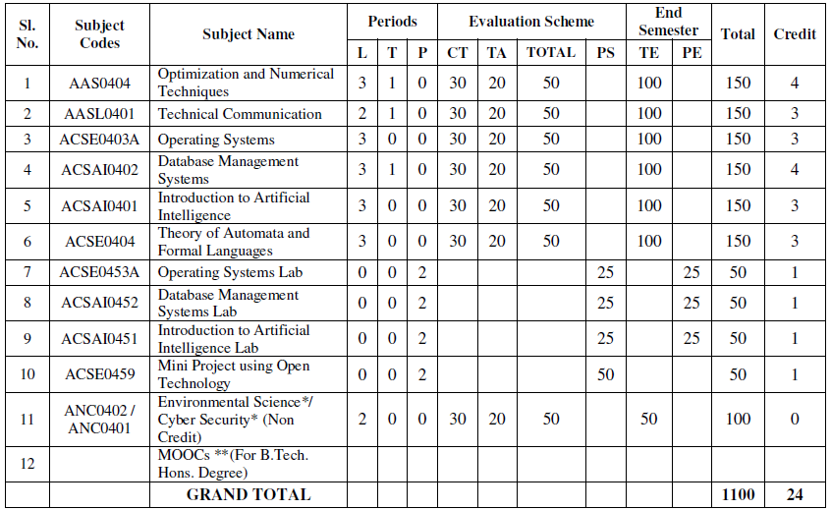
Evaluation Scheme
2/22/2024
Jaya Nidhi Vashishtha Theory of Automata and Formal Language Unit 2
3

Slide 4
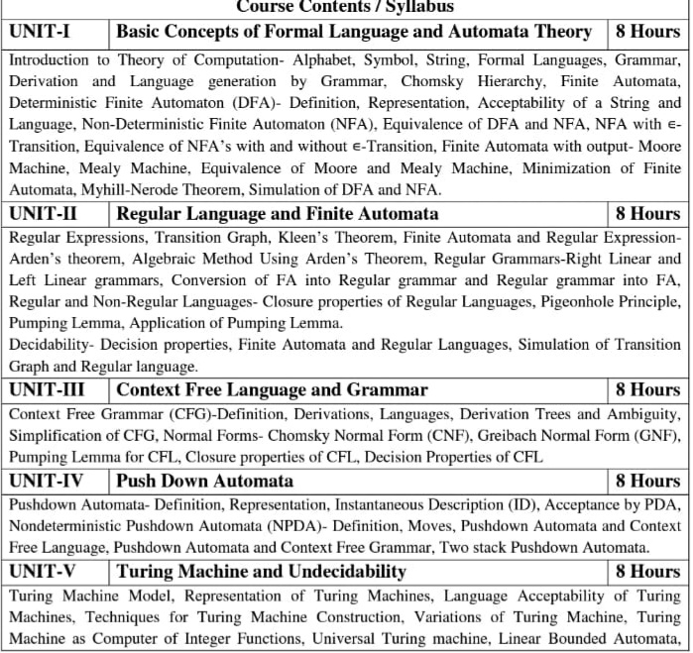
Syllabus

Slide 5
Branch wise Applications
Computer Science
Automaton is nothing but a machine which accepts the strings of a language L over an input alphabet Σ. There are four different types of Automata that are mostly used in the theory of computation (TOC).
Finite-state machine (FSM).
Pushdown automata (PDA).
Linear-bounded automata (LBA).
Turing machine (TM).

Slide 6
Course Objectives
The primary objective of this course is to introduce students to the foundations of computability theory. The other objectives include:
Introduce concepts in automata theory and theory of computation
Identify different formal language classes and their relationships
Design grammars and recognizers for different formal languages
Prove or disprove theorems in automata theory using its properties
Determine the decidability and intractability of computational problems

Slide 7
Course Outcomes
CO | At the end of course , the student will be able to | Bloom’s (KL)
CO1 | Design and Simplify automata for formal languages and transform non-deterministic finite automata to deterministic finite automata. | K₆
CO2 | Identify the equivalence between the regular expression and finite automata and apply closure properties of formal languages to construct finite automata for complex problems. | K₃
CO3 | Define grammar for context free languages and use pumping lemma to disprove a formal language being context- free. | K₃
CO4 | Design pushdown automata (PDA) for context free languages and Transform the PDA to context free grammar and vice-versa. | K₆
CO5 | Construct Turing Machine for recursive and recursive enumerable languages. Identify the decidable and undecidable problems. | K₆

Slide 8
Program Outcomes (POs)
Engineering Graduates will be able to:
1. Engineering knowledge: Apply the knowledge of mathematics, science, engineering fundamentals, and an engineering specialization to the solution of complex engineering problems.
2. Problem analysis: Identify, formulate, review research literature, and analyze complex engineering problems reaching substantiated conclusions using first principles of mathematics, natural sciences, and engineering sciences.
3. Design/development of solutions: Design solutions for complex engineering problems and design system components or processes that meet the specified needs with appropriate consideration for the public health and safety, and the cultural, societal, and environmental considerations.
4. Conduct investigations of complex problems: Use research-based knowledge and research methods including design of experiments, analysis and interpretation of data, and synthesis of the information to provide valid conclusions.

Slide 9
Program Outcomes (POs)
Contd..
5. Modern tool usage: Create, select, and apply appropriate techniques, resources, and modern engineering and IT tools including prediction and modeling to complex engineering activities with an understanding of the limitations.
6. The engineer and society: Apply reasoning informed by the contextual knowledge to assess societal, health, safety, legal and cultural issues and the consequent responsibilities relevant to the professional engineering practice.
7. Environment and sustainability: Understand the impact of the professional engineering solutions in societal and environmental contexts, and demonstrate the knowledge of, and need for sustainable development.
8. Ethics: Apply ethical principles and commit to professional ethics and responsibilities and norms of the engineering practice.

Slide 10
Program Outcomes (POs)
Contd..
9. Individual and team work: Function effectively as an individual, and as a member or leader in diverse teams, and in multidisciplinary settings.
10. Communication: Communicate effectively on complex engineering activities with the engineering community and with society at large, such as, being able to comprehend and write effective reports and design documentation, make effective presentations, and give and receive clear instructions.
11. Project management and finance: Demonstrate knowledge and understanding of the engineering and management principles and apply these to one’s own work, as a member and leader in a team, to manage projects and in multidisciplinary environments.
12. Life-long learning: Recognize the need for, and have the preparation and ability to engage in independent and life-long learning in the broadest context of technological change.

Slide 11
CO-PO Correlation Matrix
 | PO1 | PO2 | PO3 | PO4 | PO5 | PO6 | PO7 | PO8 | PO9 | PO10 | PO11 | PO12
CO1 | 2 | 2 | 3 | 3 | 2 | 2 | - | - | 2 | 1 | - | 3
CO2 | 1 | 3 | 2 | 3 | 2 | 2 | - | 1 | 1 | 1 | 2 | 2
CO3 | 2 | 2 | 3 | 2 | 2 | 2 | - | 2 | 2 | 1 | 2 | 3
CO4 | 2 | 2 | 2 | 3 | 2 | 2 | - | 2 | 2 | 1 | 1 | 3
CO5 | 3 | 2 | 2 | 2 | 2 | 2 | - | 2 | 1 | 1 | 1 | 2
Average | 2 | 2.2 | 2.4 | 2.6 | 2 | 2 | - | 1.4 | 1.6 | 1 | 1.2 | 2.6

Slide 12
CO-PO Correlation Matrix
CO-PO correlation matrix w.r.t. Unit-2
 | PO1 | PO2 | PO3 | PO4 | PO5 | PO6 | PO7 | PO8 | PO9 | PO10 | PO11 | PO12
CO2 | 1 | 3 | 2 | 3 | 2 | 2 | - | 1 | 1 | 1 | 2 | 2

Slide 13
Program Specific Outcomes (PSOs)
On successful completion of graduation degree the Computer Science &
Engineering graduates will be able to:
PSO1: | Identify, analyze real world problems and design their ethical solutions using artificial intelligence, robotics, virtual/augmented reality, data analytics, block chain technology, and cloud computing.
PSO2: | Design and develop the hardware sensor devices and related interfacing software systems for solving complex engineering problems.
PSO3: | understand inter-disciplinary computing techniques and to apply them in the design of advanced computing.
PSO4: | Conduct investigation of complex problem with the help of technical, managerial, leadership qualities, and modern engineering tools provided by industry sponsored laboratories.

Slide 14
CO-PSO Correlation Matrix
CO | PSO
 | PSO1 | PSO2 | PSO3 | PSO4
CO1 | 2 | 2 | 2 | 2
CO2 | 2 | 2 | 1 | 1
CO3 | 2 | 2 | 1 | 1
CO4 | 2 | 2 | 1 | 1
CO5 | 2 | 2 | 2 | 2
Average | 2 | 2 | 1.4 | 1.4

Slide 15

CO-PSO Correlation Matrix
CO-PSO correlation matrix w.r.t. Unit-2
CO | PSO
 | PSO1 | PSO2 | PSO3 | PSO4
CO2 | 2 | 2 | 1 | 1

Slide 16
Program Educational Objectives (PEOs)
PEO1: To have an excellent scientific and engineering breadth so as to comprehend, analyze, design and solve real-life problems using state-of-the-art technologies.
PEO2: To lead a successful career in industries, to pursue higher studies or to support entrepreneurial endeavors so that engineering graduates can face the global challenges.
PEO3:To effectively bridge the gap between industry and academia through effective communication skill, professional attitude, ethical values and a desire to learn.
PEO4: To provide highly competitive environment and solidarity to students for successful professional career as engineer, scientist, entrepreneur and bureaucrats for the betterment of society.

Slide 17
CO-PEO Correlation Matrix
CO | PEO
 | PEO1 | PEO2 | PEO3 | PEO4
CO1 | 2 | 2 | 1 | 2
CO2 | 2 | 2 | 1 | 1
CO3 | 2 | 2 | 2 | 2
CO4 | 2 | 2 | 1 | 1
CO5 | 2 | 2 | 1 | 2
Average | 2 | 2 | 1.2 | 2

Slide 18
Result Analysis
Subject Result:
Section A: 95.65%
Section B: 97.14%
Section C: 84.51%
Section D: 94.29%

Slide 19
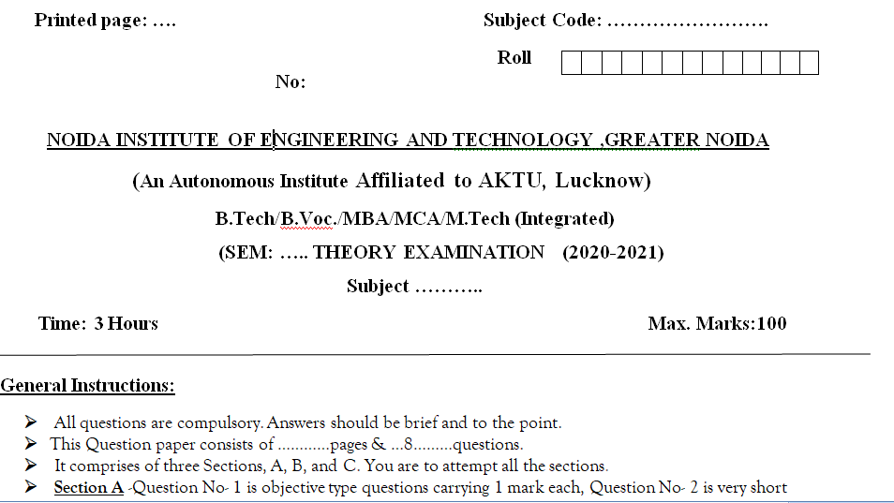
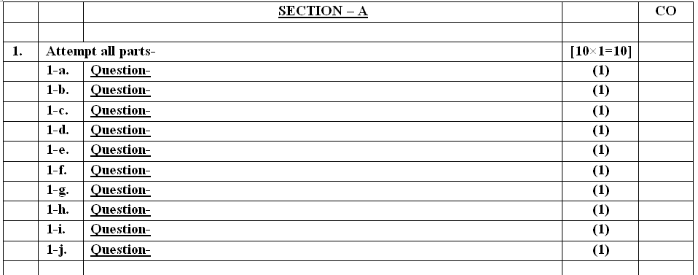
End Semester Question Paper Template

Slide 20
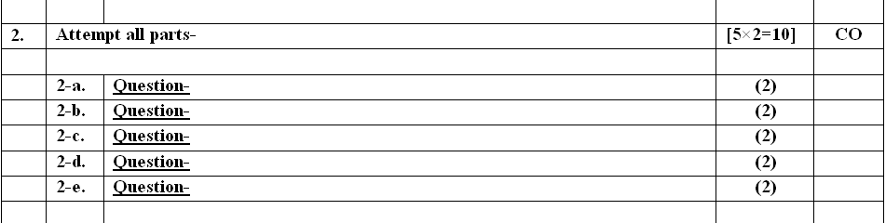
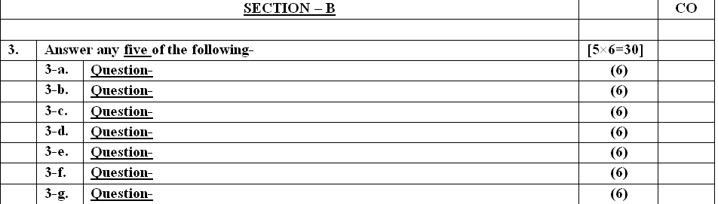
End Semester Question Paper Template

Slide 21
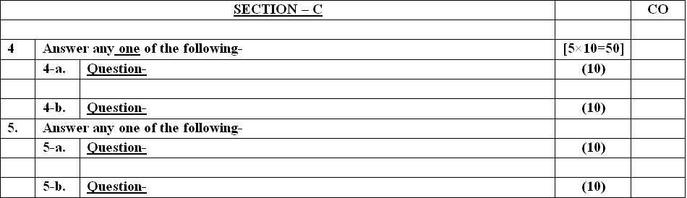
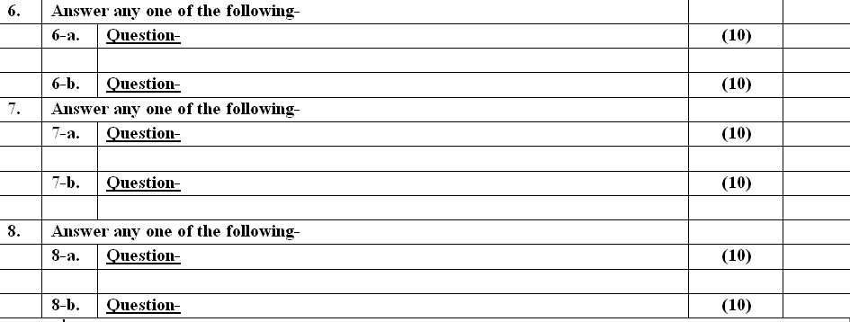
End Semester Question Paper Template

Slide 22
Prerequisite
DFA and NFA are used to accept regular languages.
Mealy and Moore machines are used to generate output.
DFA and NFA have same power.
It is easy to construct Ɛ-NFA.

Slide 23
Recap
Finite automata is a machine that acccepts regular languages.
FA has its application in many fields like compiler design, digital circuits, etc.
NFA and DFA has same expressive power.
NFA is easy to construct than DFA.
Every NFA is equivalent to DFA.
Myhill-Nerode theorem is used to optimize the FA.

Slide 24
Syllabus
UNIT II
Regular Language and Finite Automata
Regular Expressions, Transition Graph, Kleen’s Theorem, Finite Automata and Regular Expression- Arden’s theorem, Algebraic Method Using Arden’s Theorem, Regular Grammars-Right Linear and Left Linear grammars, Conversion of FA into Regular grammar and Regular grammar into FA, Regular and Non-Regular Languages- Closure properties of Regular Languages, Pigeonhole Principle, Pumping Lemma, Application of Pumping Lemma.
Decidability- Decision properties, Finite Automata and Regular Languages, Simulation of Transition
Graph and Regular language.

Slide 25

Links
UNIT 1-https://www.youtube.com/watch?v=58N2N7zJGrQ&list=PLBlnK6fEyqRgp46KUv4ZY69yXmpwKOIev
UNIT 2-
https://www.youtube.com/watch?v=rjG5LwbqAp4
UNIT 3-
https://www.youtube.com/watch?v=SlSA9vEXCm4
UNIT 4-
https://www.youtube.com/watch?v=7lcwlNNCP1E
UNIT 5-
https://www.youtube.com/watch?v=LE_7krgRGt8

Slide 26
UNIT-2
Topics | Duration (in Hours)
Regular Expressions | 4
Regular Languages | 2
Pumping Lemma | 2
Decision properties | 1
Finite Automata and Regular Languages | 1

Slide 27
Objective of Unit
Objective of the course is to make students able to:
Write regular expression.
Correlate between regular expression and FA.
Apply Arden’s Theorem.
Use pumping lemma for regular languages.

Slide 28
Regular Expressions (CO2)
Objective of the Topic
The objective of the topic is to make the student able to:
Understand application of regular expression.
Write regular expression
Realize the expressive power of RE and FA
Convert FA to RE and vice-versa.

Slide 29
Regular Expression(RE) (CO2)
Topic mapping with Course Outcome
Topic | CO1 | CO2 | CO3 | CO4 | CO5
Regular Expression | - | 3 | - | - | -

Slide 30
Regular Expression(RE)
We have already discussed that languages accepted by Finite Automata are called Regular Language.
Regular expressions are an algebraic way to describe languages.
They describe exactly the regular languages.
If E is a regular expression, then L(E) is the language it defines.
We’ll describe RE’s and their languages recursively.
An expression that express the regular language is called the regular Expression
RE is written for the Regular Language using +, . , * is known as Regular Expression.
Examples
(a+b)
(0+10*)
(a+Ɛ)b*a
(ab+ba)*

Slide 31
Regular Expression(RE)
Formally a regular expression is defined recursively as
Any terminal symbol (i.e. an element of ∑:), Ɛ and φ are regular expressions. When we view a in ∑ as a regular expression, we denote it by a.
The union of two regular expressions R1 and R2• written as R1+ R2, is also a regular expression.
The concatenation of two regular expressions R1 and R2, written as R1 R2, is also a regular expression.
The iteration (or closure) of a regular expression R written as R*, is also a regular expression.
If R is a regular expression, then (R) is also a regular expression.
The regular expressions over ∑ are precisely those obtained recursively by the application of the rules 1-5 once or several times.

Slide 32
Regular Expression(RE)
Basis 1: If a is any symbol, then a is a RE, and L(a) = {a}.
Note: {a} is the language containing one string, and that string is of length 1.
Basis 2: ε is a RE, and L(ε) = {ε}.
Basis 3: ∅ is a RE, and L(∅) = ∅.
Induction 1: If E₁ and E₂ are regular expressions, then E₁+E₂ is a regular expression, and L(E₁+E₂) = L(E₁)∪L(E₂).
Induction 2: If E₁ and E₂ are regular expressions, then E₁E₂ is a regular expression, and L(E₁E₂) = L(E₁)L(E₂).
Concatenation : the set of strings wx such that w
Is in L(E₁) and x is in L(E₂).

Slide 33
Regular Expression(RE)
Induction 3: If E is a RE, then E* is a RE, and L(E*) = (L(E))*.
Closure, or “Kleene closure” = set of strings
w₁w₂…w_{n}, for some n > 0, where each w_{i} is
in L(E).
Note: when n=0, the string is ε.
Precedence of Operators
Parentheses may be used wherever needed to influence the grouping of operators.
Order of precedence is * (highest), then concatenation, then + (lowest).

Slide 34
DFA, NFA, Ɛ-NFA and Regular Expression(RE)
RE
DFA
Ɛ-NFA
NFA

Slide 35
DFA, Regular Languages,Regular Expressions
Finite Automata | Regular Language | Regular Expression
 | {Ɛ} | RE = Ɛ
 | {φ} | RE = φ
 | {a} | RE = a
 | {a, b} | RE = a+b
q0
q0
a
q1
q0
a
q1
a
q0
b
q1

Slide 36
DFA, Regular Languages, Regular Expressions
Finite Automata | Regular Language | Regular Expression
 | {ab} | RE = a.b
 | {Ɛ,a,aa,aaa,……} | RE = a*
 | {a,aa,aaa,…….} | RE = a.a* = a⁺
 | {Ɛ, ab,abab,…….} | RE = (ab)*
q0
a
q1
b
q2
q0
a
a
q0
a
q1
a
q0
q1
b

Slide 37
Regular Expressions, Regular Languages
Regular Expressions | Regular Languages
(0 + 10*) | L = { 0, 1, 10, 100, 1000, 10000, … }
(0*10*) | L = {1, 01, 10, 010, 0010, …}
(0 + ε)(1 + ε) | L = {Ɛ, 0, 1, 01}
(a+b)* | L = {Ɛ, a, b, aa , ab , bb , ba, aaa…….}
(a+b)*abb | L = {abb, aabb, babb, aaabb, ababb, …………..} ending with abb
(11)* | L= {Ɛ, 11, 1111, 111111, ……….}
(aa)*(bb)*b | Set of strings consisting of even number of a’s followed by odd number of b’s , so L = {b, aab, aabbb, aabbbbb, aaaab, aaaabbb, …………..}
(aa + ab + ba + bb)* | String of a’s and b’s of even length can be obtained by concatenating any combination of the strings aa, ab, ba and bb including null, so L = {Ɛ, aa, ab, ba, bb, aaab, aaba, …………..}

Slide 38
Identities of Regular Expression
I₁: R + ∅ = ∅ + R = R
I₂: R. ∅ = ∅
I₃: R.ε = ε.R = R
I₄: ε* = ε
I₅: R+R=R
I₆: R*R* = R*
I₇: RR* = R*R
I₈: (R*)* = R*
I₉: ε + RR* = ε + R*R = R*
I₁₀: (PQ)*P =P(QP)*
I₁₁: (P+Q)* = (P*Q*)* = (P*+Q*)*
I₁₂: PQ+PR = P(Q+R) and QP+RP = (Q+R)P

Slide 39
Examples of Regular Expression
L(01) = {01}.
L(01+0) = {01, 0}.
L(0(1+0)) = {01, 00}.
Note order of precedence of operators.
L(0*) = {ε, 0, 00, 000,… }.
L((0+10)*(ε+1)) = all strings of 0’s and 1’s without two consecutive 1’s.

Slide 40
Examples of Regular Expression
Q1: Write the regular expression for the language accepting all combinations of a's, over the set ∑ = {a}
Solution:
All combinations of a's means a may be zero, single, double and so on. If a is appearing zero times, that means a null string. That is we expect the set of {ε, a, aa, aaa, ....}. So we give a regular expression for this as:
R = a*
That is Kleen closure of a.

Slide 41
Examples of Regular Expression
Q2: Write the regular expression for the language accepting all combinations of a's except the null string, over the set ∑ = {a}
Solution:
The regular expression has to be built for the language
L = {a, aa, aaa, ....}
This set indicates that there is no null string. So we can denote regular expression as: R = a⁺
^{Q3:} Write the regular expression for the language accepting all the string containing any number of a's and b's.
Solution:
The regular expression will be:
r.e. = (a + b)*
This will give the set as L = {ε, a, aa, b, bb, ab, ba, aba, bab, .....}, any combination of a and b.
The (a + b)* shows any combination with a and b even a null string.

Slide 42
Examples of Regular Expression
Q4: Write the regular expression for the language accepting all the string which are starting with 1 and ending with 0, over ∑ = {0, 1}.
Solution:
In a regular expression, the first symbol should be 1, and the last symbol should be 0. The r.e. is as follows:
R = 1 (0+1)* 0
Q5: Write the regular expression for the language starting and ending with a and having any having any combination of b's in between.
Solution:
The regular expression will be:
R = a b* a

Slide 43
Examples of Regular Expression
Q6:
Write the regular expression for the language starting with a but not having consecutive b's.
Solution: The regular expression has to be built for the language:
L = {a, aba, aab, aba, aaa, abab, .....}
The regular expression for the above language is:
R = {a + ab}*
Q7:
Write the regular expression for the language accepting all the string in which any number of a's is followed by any number of b's is followed by any number of c's.
Solution: As we know, any number of a's means a* any number of b's means b*, any number of c's means c*. Since as given in problem statement, b's appear after a's and c's appear after b's. So the regular expression could be:
R = a* b* c*

Slide 44
Examples of Regular Expression
Q8:Write the regular expression for the language over ∑ = {0} having even length of the string.
Solution:
The regular expression has to be built for the language:
L = {ε, 00, 0000, 000000, ......}
The regular expression for the above language is:
R = (00)*
Q9:
Write the regular expression for the language having a string which should have atleast one 0 and alteast one 1.
Solution:
The regular expression will be:
R = [(0 + 1)* 0 (0 + 1)* 1 (0 + 1)*] + [(0 + 1)* 1 (0 + 1)* 0 (0 + 1)*]

Slide 45
Examples of Regular Expression
Q10: Describe the language denoted by following regular expression
r.e. = (b* (aaa)* b*)*
Solution:
The language can be predicted from the regular expression by finding the meaning of it. We will first split the regular expression as:
r.e. = (any combination of b's) (aaa)* (any combination of b's)
L = {The language consists of the string in which a's appear triples, there is no restriction on the number of b's}
Q11:
Write the regular expression for the language L over ∑ = {0, 1} such that all the string do not contain the substring 01.
Solution:
The Language is as follows:
L = {ε, 0, 1, 00, 11, 10, 100, .....}
The regular expression for the above language is as follows:
R = (1* 0*)

Slide 46
Examples of Regular Expression
Q12:
Write the regular expression for the language containing the string over {0, 1} in which there are at least two occurrences of 1's between any two occurrences of 1's between any two occurrences of 0's.
Solution: At least two 1's between two occurrences of 0's can be denoted by (0111*0)*.
Similarly, if there is no occurrence of 0's, then any number of 1's are also allowed. Hence the r.e. for required language is:
R = (1 + (0111*0))*
Q13:
Write the regular expression for the language containing the string in which every 0 is immediately followed by 11.
Solution:
The regular expectation will be:
R = (011 + 1)*

Slide 47
Equivalence of RE’s and Automata
We need to show that for every RE, there is an automaton that accepts the same language.
Pick the most powerful automaton type: the ε-NFA.
And we need to show that for every automaton, there is a RE defining its language.
Pick the most restrictive type: the DFA.
47

Slide 48
Kleen’s Theorem
Kleene's theorem: Kleene's theorem is used to show the equivalence between regular languages, regular expressions, and finite automata. Kleene's theorem states that: For any regular expression of a language, there exists a finite automaton. The set of regular languages, the set of NFA-recognizable languages, and the set of DFA-recognizable languages are all the same. Means that For every Regular Expression corresponding to the language, a Finite Automata can be generated.
Or
Any language that can be defined by:
regular expression or finite automaton or transition graph can be defined by all three methods.
Proof: We must be able to translate between NFAs, DFAs, and regular expressions. We have covered the following algorithms to do these translations:
48

Slide 49
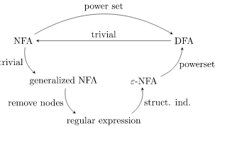
Kleen’s Theorem
Tranlations overview; DFA to NFA, NFA to regular expression (via generalized NFA), regular expression to DFA (via ε-NFA)
49

Slide 50
Arden’s Theorem
Let P and Q be two regular expressions. If P does not contain Ɛ, then
R = Q + RP has a unique solution that is
R = QP*
Proof
R=Q+RP
= Q+QP*P
= Q(Ɛ + P*P)
= QP*
So, R = QP* is a solution.
R = Q+RP
= Q + (Q + RP)P
= Q + QP + RP²
= Q + QP + (Q + RP)PP
= Q + QP + QP² + RP³
=…
=…
= Q + QP + QP² +_ _ _ _ + QP^{n} + RP^{n+1}
= Q + QP + QP² +_ _ _ _ + QP^{n} + QP*P^{n+1}
=Q ( Ɛ+ P + P2 + _ _ _ _ + P^{n} + P*P^{n+1})
=QP*
Hence, R=QP* is a Unique Solution.

Slide 51

Example of Arden’s theorem
Q1: Construct the regular expression for the given DFA
Solution:
Let us write down the equations
q1 = q1 0 + ε
Since q1 is the start state, so ε will be added, and the input 0 is coming to q1 from q1 hence we write State = source state of input × input coming to it
Similarly,
q2 = q1 1 + q2 1 q3 = q2 0 + q3 (0+1)

Slide 52
Example of Arden’s theorem
Since the final states are q1 and q2, we are interested in solving q1 and q2 only. Let us see q1 first
q1 = q1 0 + ε
We can re-write it as
q1 = ε + q1 0
Which is similar to R = Q + RP, and gets reduced to R = OP*.
Assuming R = q1, Q = ε, P = 0
We get
q1 = ε.(0)* q1 = 0* (ε.R*= R*)
Substituting the value into q2, we will get
q2 = 0* 1 + q2 1 q2 = 0* 1 (1)* (R = Q + RP → Q P*)
The regular expression is given by
r = q1 + q2 = 0* + 0* 1.1* r = 0* + 0* 1⁺ (1.1* = 1⁺)

Slide 53
Example of Arden’s theorem
Q2:Find regular expression for the following DFA using Arden’s Theorem-
Solution-
Step-01:
Form a equation for each state-
q1 = ∈ ……(1)
q2 = q1.a ……(2)
q3 = q1.b + q2.a + q3.a …….(3)
Step-02:
Bring final state in the form R = Q + RP.
Using (1) in (2), we get-
q2 = ∈.a
q2 = a …….(4)

Slide 54
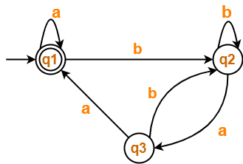
Example of Arden’s theorem
Using (1) and (4) in (3), we get-
q3 = q1.b + q2.a + q3.a
q3 = ∈.b + a.a + q3.a
q3 = (b + a.a) + q3.a …….(5)
Using Arden’s Theorem in (5), we get-
q3 = (b + a.a)a*
Thus, Regular Expression for the given DFA = (b + aa)a*
Q3: Find regular expression for the following DFA using Arden’s Theorem-

Slide 55
Example of Arden’s theorem
Step-01:
Form a equation for each state-
q1 = ∈ + q1.a + q3.a ……(1)
q2 = q1.b + q2.b + q3.b ……(2)
q3 = q2.a …….(3)
Step-02:
Bring final state in the form R = Q + RP.
Using (3) in (2), we get-
q2 = q1.b + q2.b + q2.a.b
q2 = q1.b + q2.(b + a.b) …….(4)
Using (3) in (2), we get-
q2 = q1.b + q2.b + q2.a.b
q2 = q1.b + q2.(b + a.b) …….(4)

Slide 56
Example of Arden’s theorem
Using (5) in (3), we get-
q3 = q1.b.(b + a.b)*.a …….(6)
Using (6) in (1), we get-
q1 = ∈ + q1.a + q1.b.(b + a.b)*.a.a
q1 = ∈ + q1.(a + b.(b + a.b)*.a.a) …….(7)
Using Arden’s Theorem in (7), we get-
q1 = ∈.(a + b.(b + a.b)*.a.a)*
q1 = (a + b.(b + a.b)*.a.a)*
Thus, Regular Expression for the given DFA = (a + b(b + ab)*aa)*

Slide 57
Algebraic method using Arden’s theorem
Arden’s theorem state that: “If P and Q are two regular expressions over, and if P does not contain , then the following equation in R given by R = Q + RP has a unique solution i.e., R = QP*.”
R = Q + RP ......(i)
Now, replacing R by R = QP*, we get,
R = Q + QP*P
Taking Q as common,
R = Q( + P*P) R = QP*
(As we know that + R*R = R*). Hence proved. Thus, R = QP* is the solution of the equation R = Q + RP. Now, we have to prove that this is the only solution to this equation. Let me take this equation again:
R = Q + RP
Now, replace R by R = Q + RP,
R = Q + (Q + RP)P = Q + QP + R

Slide 58
Algebraic method using Arden’s theorem
Again, replace R by R = Q + RP:-
R = Q + QP + (Q + RP) = Q + QP + Q + R = ... = ... = Q + QP + Q + .. + Q + R
Now, replace R by R = QP*, we get,
R = Q + QP + Q + .. + Q + QP*
Taking Q as common,
R = Q( + P + + .. + + P* ) = QP* [As + P + + .. + + P* represent the closure of P]
Hence proved.
Thus, R = QP* is the unique solution of the equation R = Q + RP.

Slide 59
Regular grammar Right linear
In this type of regular grammar, all the non-terminals on the right-hand side exist at the rightmost place, i.e.; right ends.
Examples :
A ⇢ a, A ⇢ aB, A ⇢ ∈ where, A and B are non-terminals,
a is terminal, and ∈ is empty string
S ⇢ 00B | 11S B ⇢ 0B | 1B | 0 | 1
where, S and B are non-terminals, and 0 and 1 are terminals

Slide 60
Regular grammar Left linear
In this type of regular grammar, all the non-terminals on the left-hand side exist at the leftmost place, i.e.; left ends.
Examples :
A ⇢ a, A ⇢ Ba, A ⇢ ∈ where, A and B are non-terminals,
a is terminal, and ∈ is empty string
S ⇢ B00 | S11 B ⇢ B0 | B1 | 0 | 1 where S and B are non-terminals, and 0 and 1 are terminals

Slide 61
Conversion of regular FA into Regular Grammar
Algorithm for conversion
The algorithm to convert the finite automata (FA) to the right linear grammar is as follows −
Step 1 − Begin the process from the start state.
Step 2 − Repeat the process for each state.
Step 3 − Write the production as the output followed by the state on which the transition is going.
Step 4 − And at last, add € (epsilon) to end the derivation.

Slide 62

Conversion of regular FA into Regular Grammar
Example:
Let’s consider a Finite automaton (FA) as given below −
Pick the start state A and output is on symbol ‘a’ going to state B
A→aB
Now we will pick state B and then we will go on each output
i.e B→aB
B→bB
B→ε
Therefore,
Final right linear grammar is as follows −
A→aB
B→aB/bB/ε

Slide 63
Conversion of regular Grammar into FA
Algorithm
The algorithm to convert the finite automata (FA) to the right linear grammar is as follows −
Step 1 − Begin the process from the start state.
Step 2 − Repeat the process for each state.
Step 3 − Write the production as the output followed by the state on which the transition is going.
Step 4 − And at last, add € (epsilon) to end the derivation

Slide 64
Conversion of regular Grammar into FA
Example 1
Let’s consider a Finite automaton (FA) as given below −
Pick the start state A and output is on symbol ‘a’ going to state B
A→aB
Now we will pick state B and then we will go on each output
i.e B→aB
B→bB
B→ε
Therefore,
Final right linear grammar is as follows −
A→aB
B→aB/bB/ε

Slide 65
Converting a RE to an ε-NFA
Proof is an induction on the number of operators (+, concatenation, *) in the RE.
We always construct an automaton of a special form (next slide).
65

Slide 66
Form of ε-NFA’s Constructed
No arcs from outside,
no arcs leaving
Start state:
Only state
with external
predecessors
“Final” state:
Only state
with external
successors
66

Slide 67
RE to ε-NFA: Basis
Symbol a:
ε:
∅:
a
ε
67

Slide 68
RE to ε-NFA: Induction 1 – Union
For E₁
ε
ε
For E₂
ε
ε
For E₁ ∪ E₂

Slide 69
RE to ε-NFA: Induction 2 – Concatenation
For E₁
For E₂
ε
For E₁E₂

Slide 70
RE to ε-NFA: Induction 3 – Closure
ε
For E
ε
ε
ε
For E*

Slide 71
DFA-to-RE
A strange sort of induction.
States of the DFA are assumed to be 1,2,…,n.
We construct RE’s for the labels of restricted sets of paths.
Basis: single arcs or no arc at all.
Induction: paths that are allowed to traverse next state in order.
71

Slide 72
k-Paths
A k-path is a path through the graph of the DFA that goes though no state numbered higher than k.
Endpoints are not restricted; they can be any state.

Slide 73
Example: k-Paths
1
0-paths from 2 to 3:
RE for labels = 0.
1
2
0
0
0
1
1
1-paths from 2 to 3:
RE for labels = 0+11.
3
2-paths from 2 to 3:
RE for labels =
(10)*0+1(01)*1
3-paths from 2 to 3:
RE for labels = ??

Slide 74
k-Path Induction
Let R_{ij}^{k} be the regular expression for the set of labels of k-paths from state i to state j.
Basis: k=0. R_{ij}⁰ = sum of labels of arc from i to j.
∅ if no such arc.
But add ε if i=j.

Slide 75
Example: Basis
1
1
2
0
0
0
R₁₂⁰ = 0.
R₁₁⁰ = ∅ + ε = ε.
1
1
3
75

Slide 76
k-Path Inductive Case
A k-path from i to j either:
Never goes through state k, or
Goes through k one or more times.
R_{ij}^{k} = R_{ij}^{k-1} + R_{ik}^{k-1}(R_{kk}^{k-1})* R_{kj}^{k-1}.
Goes from
i to k the
first time
Then, from
k to j
Doesn’t go
through k
Zero or
more times
from k to k

Slide 77
Illustration of Induction
Path to k
Paths not going
through k
i
From k to k
Several times
j
k
States < k
From k
to j

Slide 78

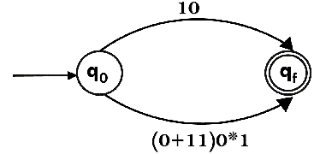
Example of RE to NFA
Design a FA from given regular expression 10 + (0 + 11)0* 1.
Solution: First we will construct the transition diagram for a given regular expression.
Step 1:
Step 2:

Slide 79
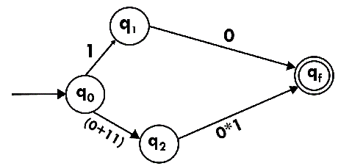
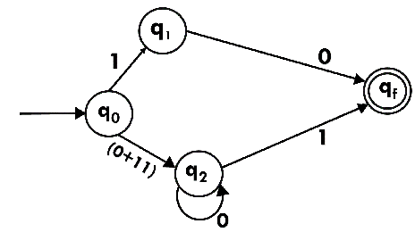
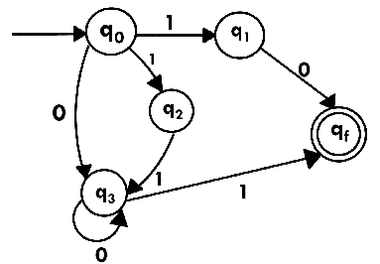
The equivalent DFA will be:
Example of RE to NFA
Step 3:
Step 4:
Step 5:
79

Slide 80
Example of RE to NFA
The equivalent DFA will be:
State | 0 | 1
→q0 | q3 | {q1, q2}
q1 | qf | ϕ
q2 | ϕ | q3
q3 | q3 | qf
*qf | ϕ | ϕ
Now we have got NFA without ε. Now we will convert it into required DFA for that, we will first write a transition table for this NFA.
State | 0 | 1
→[q0] | [q3] | [q1, q2]
[q1] | [qf] | ϕ
[q2] | ϕ | [q3]
[q3] | [q3] | [qf]
[q1, q2] | [qf] | [qf]
*[qf] | ϕ | ϕ

Slide 81

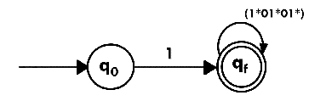
Example of RE to NFA
Design a NFA from given regular expression 1 (1* 01* 01*)*.
Solution: The NFA for the given regular expression is as follows:
Step 1:
Step 2:

Slide 82
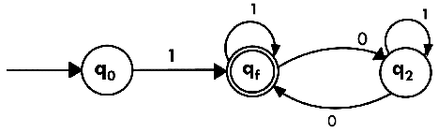

Example of RE to NFA
Step 3:
Construct the FA for regular expression 0*1 + 10.
Solution:
We will first construct FA for R = 0*1 + 10 as follows:
Step 1:

Slide 83
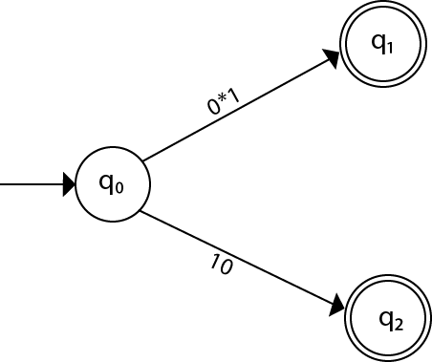
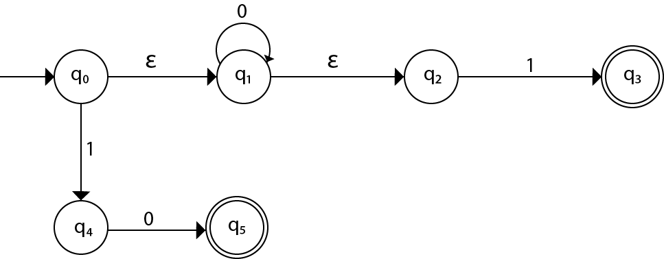
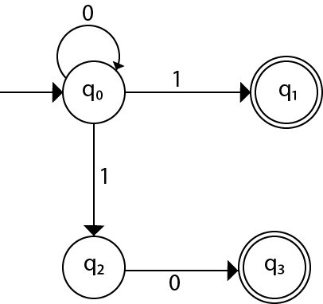
Example of RE to NFA
Step 2:
Step 3:
Step 4:
83

Slide 84
Construct an NFA for a*b*c*.
Regular Expression to NFA
a
b
c
q0
q1
q2
Ɛ
Ɛ

Slide 85
Construct an NFA for a(a+b)*b.
Regular Expression to NFA
Ɛ-NFA
a,b
q0
a
q1
Ɛ
q2
Ɛ
q3
b
q4
NFA
a,b
q0
a
q2
b
q4

Slide 86
DFA to Regular Expression
q₁ = q₀b + q₁b + q₂b
= q₀b + q₁b + (q₁a)b (Substituting value of q₂)
= q₀b + q₁(b + ab)
= q₀b (b + ab)* (Applying Arden’s Theorem)
q₀ = q₀a + q₂a + ε
= q₀a + q₁aa + ε (Substituting value of q₂)
= q₀a + q₀b(b + ab*)aa + ε (Substituting value of q₁)
= q₀(a + b(b + ab)*aa) + ε
= ε (a+ b(b + ab)*aa)*
= (a + b(b + ab)*aa)*
q₀ = q₀a + q₂a + ε
q₁ = q₀b + q₁b + q₂b
q₂ = q₁a
b
q1
a
q2
b
b
a
q0
a

Slide 87
Recap
We learnt:
Regular Expressions,
Transition Graph,
Kleen’s Theorem,
Finite Automata and Regular Expression- Arden’s theorem,
Algebraic Method Using Arden’s Theorem,

Slide 88
Regular and Non-regular Languages
Objective of the Topic
The objective of the topic is to make the student able to:
Differentiate between regular and non-regular languages.
Generate language from FA/ RE
Learn the closure properties of regular languages.
Convert FA to RE and vice-versa.

Slide 89
Regular and Non-regular Languages
Topic mapping with Course Outcome
Topic | CO1 | CO2 | CO3 | CO4 | CO5
Regular and Non –regular Languages | - | 3 | - | - | -

Slide 90
Regular and Non-regular Languages
Regular languages are accepted by Finite automata.
They are generated by Regular grammar.
Regular language can also be expressed in the form of regular expression.

Slide 91
Closure Properties of Regular Languages
Regular languages are closed under:
Complement
Concatenation
Union
Intersection
Reverse
Difference
Kleene closure
Homomorphism
Inverse homomorphism

Slide 92
Closure Properties of Regular Languages
Complement: If L is a regular language then L’ is also a regular language.
Proof
Let D(L) = (Q, Σ, δ,q0, F) be a DFA that accepts L.
Then we can construct a DFA D(L’) = (Q, Σ, δ,q0, Q-F) that accepts L’.
Make final state non final and vice-versa.

Slide 93
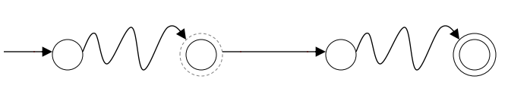
Closure Properties of Regular Languages
Concatenation: If L1 and L2 are regular languages then L1.L2 is also a regular language.
Proof: Construct NFA for L1.L2 as follows:
D(L1)
D(L2)
Ɛ
Make it Non-final

Slide 94
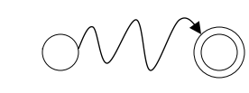
Closure Properties of Regular Languages
Union: If L1 and L2 are regular languages then L1 ∪ L2 is also a regular language.
Proof: Construct NFA for L1 ∪ L2 as follows:
D(L1)
Ɛ
D(L2)
Ɛ

Slide 95
Closure Properties of Regular Languages
Intersection: If L1 and L2 are regular languages then L1 ∩ L2 is also a regular language.
Proof: Using DeMorgan’s law:
L1 and L2 are Regular.
L1’ and L2’ are Regular.
L1’ ∪ L2’ is Regular.
is Regular.
L1 ∩ L2 is Regular.

Slide 96
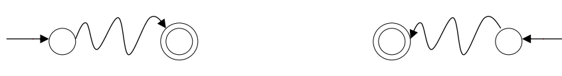
Closure Properties of Regular Languages
Reverse: If L is regular language then L^{R} is also a regular language.
Proof: Construct NFA for L^{R} as follows:
Reverse all transitions
Make the initial state final and final state initial.
D(L)
D(L^{R})

Slide 97
Closure Properties of Regular Languages
Difference: If L1 and L2 are regular languages then L1 - L2 is also a regular language.
Proof:
L1 and L2 are Regular.
L1’ is Regular.
is Regular.

Slide 98
Closure Properties of Regular Languages
Kleene Closure: If L is regular language then L* is also a regular language.
Proof: Construct NFA for L* as follows:
D(L)
Ɛ
Ɛ

Slide 99
Closure Properties of Regular Languages
Homomorphism:
A homomorphism is function h : Σ∗ → ∆∗ defined as follows:
• h(Ɛ) = Ɛ and for a ∈ Σ, h(a) is any string in ∆∗
• For a = a1a2 . . . an ∈ Σ∗ (n ≥ 2), h(a) = h(a1)h(a2). . . h(an).
• A homomorphism h maps a string a ∈ Σ∗ to a string in ∆∗ by mapping each character of a to a string h(a) ∈ ∆∗
• A homomorphism is a function from strings to strings that “respects” concatenation: for any x, y ∈ Σ ∗ , h(xy) = h(x)h(y). (Any such function is a homomorphism.)
Example. h : {0, 1} → {a, b}∗ where h(0) = ab and h(1) = ba. Then h(0011) = ababbaba

Slide 100
Closure Properties of Regular Languages
Homomorphism:
Regular languages are closed under homomorphism, i.e., if L is a regular language and h is a homomorphism, then h(L) is also regular.
Proof. We will use the representation of regular languages in terms of regular expressions to argue this.
• Define homomorphism as an operation on regular expressions
• Show that L(h(R)) = h(L(R))
• Let R be such that L = L(R). Let R0 = h(R). Then h(L) = L(R0 ).

Slide 101
Closure Properties of Regular Languages
Homomorphism:
Regular languages are closed under homomorphism, i.e., if L is a regular language and h is a homomorphism, then h(L) is also regular.
Proof. We will use the representation of regular languages in terms of regular expressions to argue this.
• Define homomorphism as an operation on regular expressions
• Show that L(h(R)) = h(L(R))
• Let R be such that L = L(R). Let R0 = h(R). Then h(L) = L(R0 ).

Slide 102
Pigeon Hole Principle
the pigeonhole principle states that if n items are put into m containers, with n > m, then at least one container must contain more than one item.
The principle has several generalizations and can be stated in various ways. In a more quantified version: for natural numbers k and m, if n = km + 1 objects are distributed among m sets, then the pigeonhole principle asserts that at least one of the sets will contain at least k + 1 objects.^{[4]} For arbitrary n and m, this generalizes to {\displaystyle k+1=\lfloor (n-1)/m\rfloor +1=\lceil n/m\rceil ,} where {\displaystyle \lfloor \cdots \rfloor } and {\displaystyle \lceil \cdots \rceil } denote the floor and ceiling functions, respectively.

Slide 103
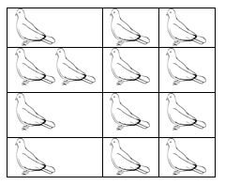
Pigeon Hole Priciple

Slide 104
Pigeon Hole Priciple
Theorem –
I) If “A” is the average number of pigeons per hole, where A is not an integer then
At least one pigeon hole contains ceil[A] (smallest integer greater than or equal to A) pigeons
Remaining pigeon holes contains at most floor[A] (largest integer less than or equal to A) pigeons
II) We can say as, if n + 1 objects are put into n boxes, then at least one box contains two or more objects. The abstract formulation of the principle: Let X and Y be finite sets and let be a function.
If X has more elements than Y, then f is not one-to-one.
If X and Y have the same number of elements and f is onto, then f is one-to-one.
If X and Y have the same number of elements and f is one-to-one, then f is onto.
Pigeonhole principle is one of the simplest but most useful ideas in mathematics. We will see more applications that proof of this theorem.

Slide 105
Pigeon Hole Priciple
Example – 2: A bag contains 10 red marbles, 10 white marbles, and 10 blue marbles. What is the minimum no. of marbles you have to choose randomly from the bag to ensure that we get 4 marbles of same color? Solution: Apply pigeonhole principle. No. of colors (pigeonholes) n = 3 No. of marbles (pigeons) K+1 = 4 Therefore the minimum no. of marbles required = Kn+1 By simplifying we get Kn+1 = 10. Verification: ceil[Average] is [Kn+1/n] = 4 [Kn+1/3] = 4 Kn+1 = 10 i.e., 3 red + 3 white + 3 blue + 1(red or white or blue) = 10

Slide 106
Pumping Lemma for Regular Languages
Objective of the Topic
The objective of the topic is to make the student able to:
Apply pumping lemma.
Prove that a language is not regular

Slide 107
Pumping Lemma for Regular Languages
Topic mapping with Course Outcome
Topic | CO1 | CO2 | CO3 | CO4 | CO5
Pumping Lemma for Regular Languages | - | 3 | - | - | -

Slide 108
Pumping Lemma for Regular Languages
L1 = {a^{m}b^{n}, m,n >=0} is a regular language.
L2 = {a^{n}b^{n}, n >=0} is not a regular language.
L3 = {w|w has an equal number of 0s and 1s} is not a regular language.
Pumping Lemma is used to prove that a language is not regular.
It can not be used to prove that a language is regular.
Pumping Lemma
If L is a Regular Language, then there is a number m (the pumping length) where if w is any string in L of length at least m, then w may be divided into 3 pieces, w = xyz, satisfying the following conditions:
a. xy^{i}z ∈ L, For each i ≥ 0
b. |y| > 0, and
c. |xy| ≤ m.

Slide 109
Pumping Lemma for Regular Languages
Process to use Pumping lemma
Assume that L is regular.
So, the pumping lemma should hold for L.
Use the pumping lemma to obtain a contradiction
Select w such that |w| ≥ m
Divide w into x, y and z
Select y such that |y| ≥ 1
Select x such that |xy| ≤ m
Assign the remaining string to z.
Pump y such that xy^{i}z ∉ L.
By contradiction say L is not regular.

Slide 110
Pumping Lemma for Regular Languages
Prove that L = {a^{n}b^{n} | n ≥ 0} is not regular.
Solution −
Assume that L is regular and m is the number of states.
Let w = a^{m}b^{m}. Thus |w| = 2m ≥ m.
By pumping lemma, let w = xyz, where |xy| ≤ m.
Let x = a^{p}, y = a^{q}, and z = a^{r}b^{m}, where p + q + r = m, p ≠ 0, q ≠ 0, r ≠ 0. Thus |y| ≠ 0.
Let k = 2. Then xy²z = a^{p}a^{2q}a^{r}b^{m}.
Number of as = (p + 2q + r) = (p + q + r) + q = m + q
Hence, xy²z = a^{m+q} b^{m}. Since q ≠ 0, xy²z is not of the form a^{n}b^{n}.
Thus, xy²z is not in L. Hence L is not regular.
https://www.yumpu.com/en/document/read/31123078/visualizing-the-pumping-lemma-for-regular-

Slide 111
Decision Properties of Regular Languages
Following properties are decidable for Finite Automata.
Emptiness
To determine whether FA accepts any language or not?
Finiteness
To determine whether Language accepted by FA is finite or infinite?
Membership
To determine whether string w is accepted by FA or not?
Equality
To determine whether two FA are accepting same language.

Slide 112
Decision Properties of Regular Languages
Emptiness:
Step-1: Remove unreachable states.
Step 2: If the resulting machine contains at least one final states, then the finite automata accepts language.
Step 3: if there is no final state, then finite automata accepts empty language.
Finiteness:
Step-1: Remove unreachable states.
Step-2: Remove dead states.
Step-3: If the resulting machine contains loops or cycles then the FA accepts infinite language.
Step-4: If the resulting machine do not contain loops or cycles then the FA accepts finite language.

Slide 113
Decision Properties of Regular Languages
Membership: Let M is a finite automata that accepts some strings over an alphabet, and let ‘w’ be any string defined over the alphabet, if there exist a transition path in M, which starts at initial state & ends in anyone of the final state, then string ‘w’ is a member of M, otherwise ‘w’ is not a member of M.
Equality: Two finite state automata M1 & M2 is said to be equal if and only if, they accept the same language.
Minimise the finite state automata and the minimal DFA will be unique.

Slide 114
Limitations of FA
FA can not be constructed for
Context Free Grammar
Context sensitive Grammar
Recursive Enumerable Grammar
Calculation can not be done with FA.
There is no storage in FA.
FA can not modify the input (as Turing Machine does).

Slide 115
Video Links
My Video Channel:
https://www.youtube.com/playlist?list=PLKhyqvN-JcP5AF4UzRz9wxFVBm63igm7y
NPTEL Video Links
https://youtu.be/vQeROGcwQs4
https://youtu.be/XxuH_K-wzpg
https://youtu.be/C7LqbEunJ1Y

Slide 116
Daily Quiz
1. If L1 and L2 are regular languages is/are also regular language(s).
L1 + L2
L1L2
L1’
All of above
2. Every regular expression can be expressed as CFG but every CFG cannot be expressed as a regular expression. this statement is :
True
False
depends on language
None of the option

Slide 117
Daily Quiz
3. In pumping Lemma, If we select a string w such that w∈L, and w=xyz. Which of the following portions cannot be an empty string?
x
y
z
all of the mentioned
4.The total number of states required to automate the given regular expression(00)*(11)*
3
5
6
2

Slide 118
Daily Quiz
5. Moore machine produce the output string of length ---------- corresponding to n length input string
n
n+1
n-1
2n
6. Which of the following does not represents the given language over {a,b} ?
a+ab
{a} U {ab}
{a} U {a}{b}
{a} ^ {ab}

Slide 119
Daily Quiz
7. The given NFA corresponds to which of the following Regular expressions?
(0+1) *(00+11) (0+1) ⁺
(0+1) *(00+11) *(0+1) *
(0+1) *(00+11) (0+1)
(0+1) (00+11) (0+1) *

Slide 120
Daily Quiz
8. Regular grammar is a) context free grammar b) non context free grammar c) English grammar d) none of the mentioned
9. Which of the following is true? a) Every subset of a regular set is regular b) Every finite subset of non-regular set is regular c) The union of two non regular set is not regular d) Infinite union of finite set is regular
10. Regular expressions are closed under a) Union b) Intersection c) Kleen star d) All of the mentioned

Slide 121
Weekly Assignment
1. Find a regular expression corresponding to each of the following subsets of {a. b}. [CO2]
The set of all strings containing exactly 2a’s.
The set of all strings containing at least 2a’s.
The set of all strings containing at most 2a's.
The set of a]] strings containing the substring aa.
2. Find the sets represented by the following regular expressions. [CO2]
(a + b)*(aa + bb + ab + ba)*
(aa)* + (aaa)*
(1 + 01 + 001)*(∊+ 0 + 00)
a + b(a + b)*

Slide 122
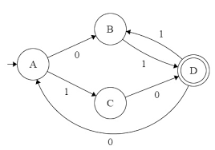
Weekly Assignment
Prove the identity: (a*ab + ba)*a* = (a + ab + ba)* [CO2]
State Pumping Lemma for Non-Regular languages. Prove that the language L= (a^{q} where q is a prime number} is a Non regular language. [CO2]
Show that L = {aib^{j}c^{k}| k>i+j} is not regular. [CO2]
Find the regular expression corresponding to the automaton given in Fig.

Slide 123
Weekly Assignment
7. State and prove Arden’s theorem. Give a regular expression for the Finite Automaton M=[{A ,B, C, D}, {a, b}, δ, A, {A}] where δ is given below: [CO2]
δ (A, a) = B δ (A, b) = C
δ (B, a) = D δ (B, b) = A
δ (C, a} = A δ (C, b) = D
δ (D, a) = D δ (D, b) = D
8. Explain the Chomsky hierarchy of formal languages. Define the relationship between languages and corresponding machine. [CO2]

Slide 124
Weekly Assignment
9. Design a Mealy Machine which reads input from {0, 1} and outputs are EVEN or ODD according to total number of 1’s are even or odd. Also convert that Mealy Machine into Corresponding Moore Machine. [CO2]
10.Construct a finite automaton recognizing L(G), where G is the grammar S →a S | bA| b and A →aA| bS| a. [CO2]

Slide 125
MCQ s
Which of the following are decision properties?
Emptiness
Infiniteness
Membership
All of the mentioned
In pumping lemma theorem (x y^n z) the range of n is
n=1, 2, 3, 4……….
n=0, 1, 2, 3, 4……….
n=…….-3,-2,-1, 0, 1, 2, 3, 4……
n=…….-3,-2,-1, 1, 2, 3, 4……

Slide 126
MCQ s
Let S and T be language over ={a,b} represented by the regular expressions (a+b*)* and (a+b)*, respectively. Which of the following is true?
S is a subset of T
T is a subset of S
S=T
S intersection T=Ø
The logic of pumping lemma is good example of
the pigeon hole principle
divide and conquer
recursion
iteration

Slide 127
MCQ s
Let a Grammar G is defined by the production S→aS | bS , then language generated by Grammar is defined as
Φ
∊
{a,b}*
{a,b}+
Which of the following is true?
(01)*0 = 00(10)*
(0+1)*0(0+1)*1(0+1) = (0+1)*01(0+1)*
(0+1)*01(00+1)*+1*0* = (0+1)*
All of the mentioned

Slide 128
MCQ s
Which among the following looks similar to the given expression? ((0+1). (0+1))*
{xϵ {0,1} *|x is all binary number with even length}
{xϵ {0,1} |x is all binary number with even length}
{xϵ {0,1} *|x is all binary number with odd length}
{xϵ {0,1} |x is all binary number with odd length}
Which of the following represents a language which has no pair of consecutive 1’s if ∑= {0,1}?
(0+10)*(1+ε)
(0+10)*(1+ε)*
(0+101)*(0+ε)
(1+010)*(1+ε)

Slide 129
Old Question Papers
2001-2019
2022-23
2021-22

Slide 130
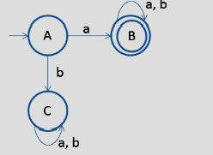
Expected Questions for University Exam
Find regular expression over ∑={a,b} for all strings containing either the sub string ‘aaa’ or ‘bbb’.
Write regular expression for set of all strings such that number of a’s divisible by 3 over Σ = {a,b}.
State the pumping lemma theorem for regular languages.
Convert the FA given below to left linear grammar.
Show that L = {a^{i} b^{j} c^{k} | k > i + j} is not regular.

Slide 131
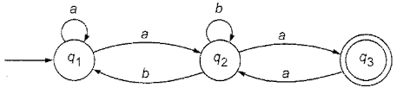
Expected Questions for University Exam
Find the regular expression for the given FA.
For the two regular expressions :
r1 = a* + b* r2 = ab* + ba* + b*a + (a*b)*
a. Find a string corresponding to r2 but not to r1 and
b. Find a string corresponds to both r1 and r2.

Slide 132
Summary
Regular expressions are used for regular languages.
Using Arden’s theorem a FA is converted into regular expression.
Regular expression is converted into Ɛ-NFA.
Pumping lemma is used to prove that a language is not regular.
Regular languages are closed under union, intersection, complement, reverse, concatenation and kleene closure.

Slide 133
References
Hopcroft, J. E., Motwani, R., & Ullman, J. D. (2001). Introduction to automata theory, languages, and computation. Acm Sigact News, 32(1), 60-65.
Linz, P. (2006). An introduction to formal languages and automata. Jones & Bartlett Learning.
Mishra, K. L. P., & Chandrasekaran, N. (2006). Theory of Computer Science: Automata, Languages and Computation. PHI Learning Pvt. Ltd..

